Slide 1


CRYPTOCURRENCIES
UFV – EPS – Fundamentals of Computer Engineering – Practical Work I
18 / 11 / 2024
GROUP 1
Jorge Almirall Navarro
Miguel de Vicente Luengo
Nicolás Martínez Djekic
Johan José Merida Pérez
Hugo Prieto Petrossi
Ignacio Ramos Nicolás

Slide 2
INDEX
Index ................................................................................................................................................................................ 2
Introduction .................................................................................................................................................................... 3
Main Objectives ............................................................................................................................................................. 4
Cryptocurrencies .......................................................................................................................................................... 5
Detailed Overview ….................................................................................................................................................... 6
Technologies Involved ….............................................................................................................................................. 7
Advantages & Disadvantages …................................................................................................................................. 9
Potencial Evolution …................................................................................................................................................. 10
Ethical Analysis ............................................................................................................................................................ 11
Conclusion …............................................................................................................................................................... 15
Bibliography …............................................................................................................................................................ 16

Slide 3

INTRODUCTION
Digitalization and the economy-technology relationship
2008 crisis and distrust in conventional money
The birth of Bitcoin and the cryptocurrency ecosystem
Impact of the 2019 pandemic
Emergenceof new online payment methods
Motivation:
Interest in cryptocurrencies
Motivation to understan
-Context
-When?
-Why?

Slide 4
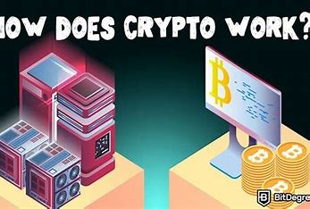
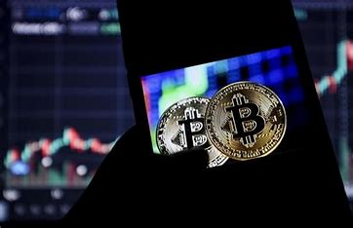

Main objetives
Understand how cryptocurrencies work
Controversy and Opportunities
Evaluation of Pro-Bitcoin Claims

Slide 5


Cryptocurrecies
Peak of digital technology
Creation of digital currency
Role of cryptography and blockchain
Adoption by companies and financial institutions
Impact of blockchain on business

Slide 6


DETAILED OVERVIEW
Decentralized digital assets
Two key concepts
-DLT
-Blockchain
No physical form
Knowledge and involvement required
Sophisticated structure with easy acces

Slide 7

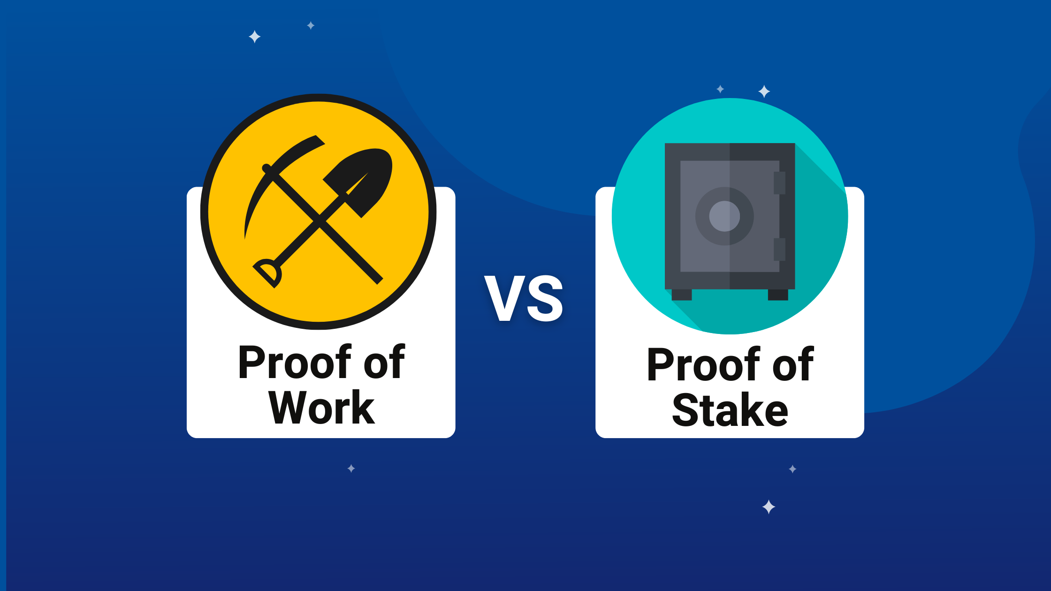
TECHNOLOGIES INVOLVED
Technology explanation approach
Blockchain Technology
Blockchain as DLT
Decentralization
Genesis Block
Proof of work
Proof of stake

Slide 8




TECHNOLOGIES INVOLVED
Cryptography in Cryptocurrencies
Public-private key pairs
Hash functions
Smart contracts
Evolution of smart contracts
NFTs

Slide 9


ADVANTAGES AND DISADVANTAGES
These are some general advantages and disadvantages in cryptocurrencies.
Advantages:
Secure and independent digital currency
Minimal fees for international transactions
Blockchain technology enhances security and privacy
Disadvantages:
High volatility
Lack of regulation
Environmental impact

Slide 10
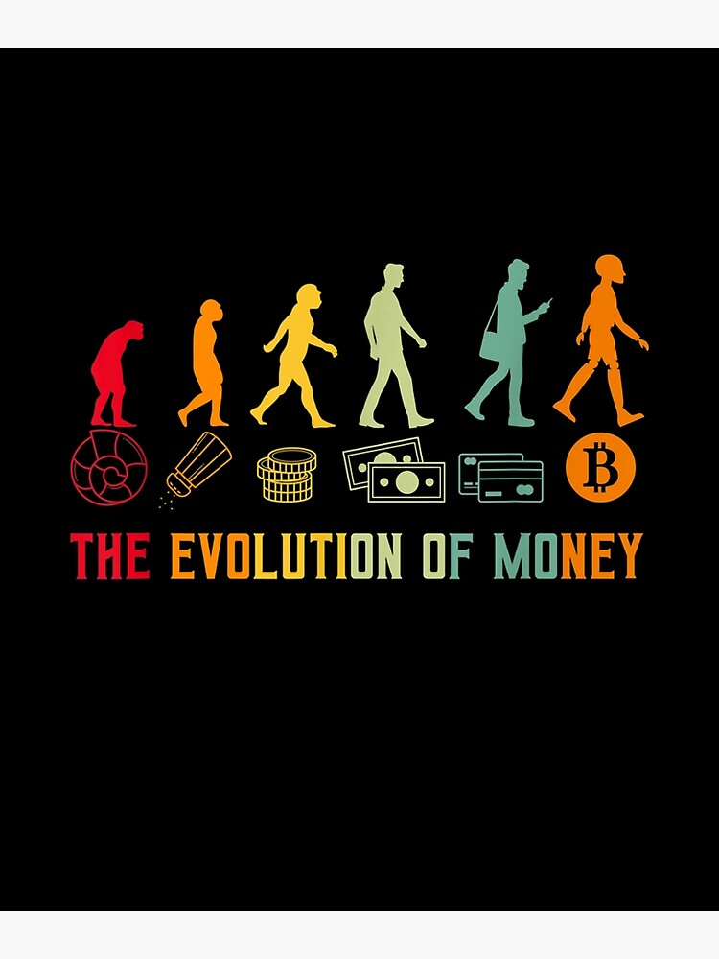
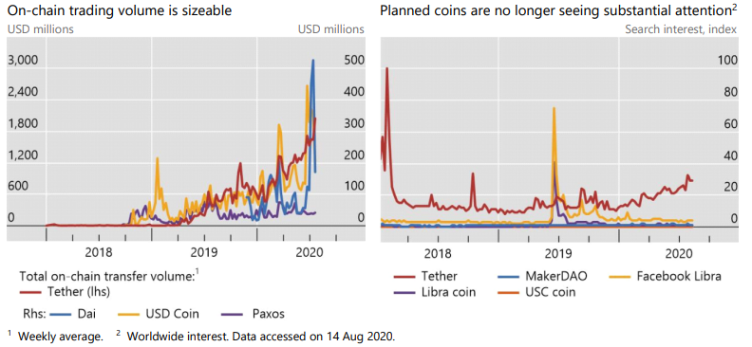
POTENTIAL EVOLUTION
Social media
Security and regulation
Adoption
Usability

Slide 11

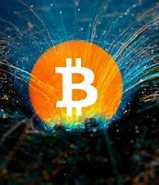


ETHICAL ANALYSIS
Ethics debate focus
Cryptocurrencies don´t hold moral status
Ethical analysis objective
Consideration of political and economic impact
Externalities

Slide 12
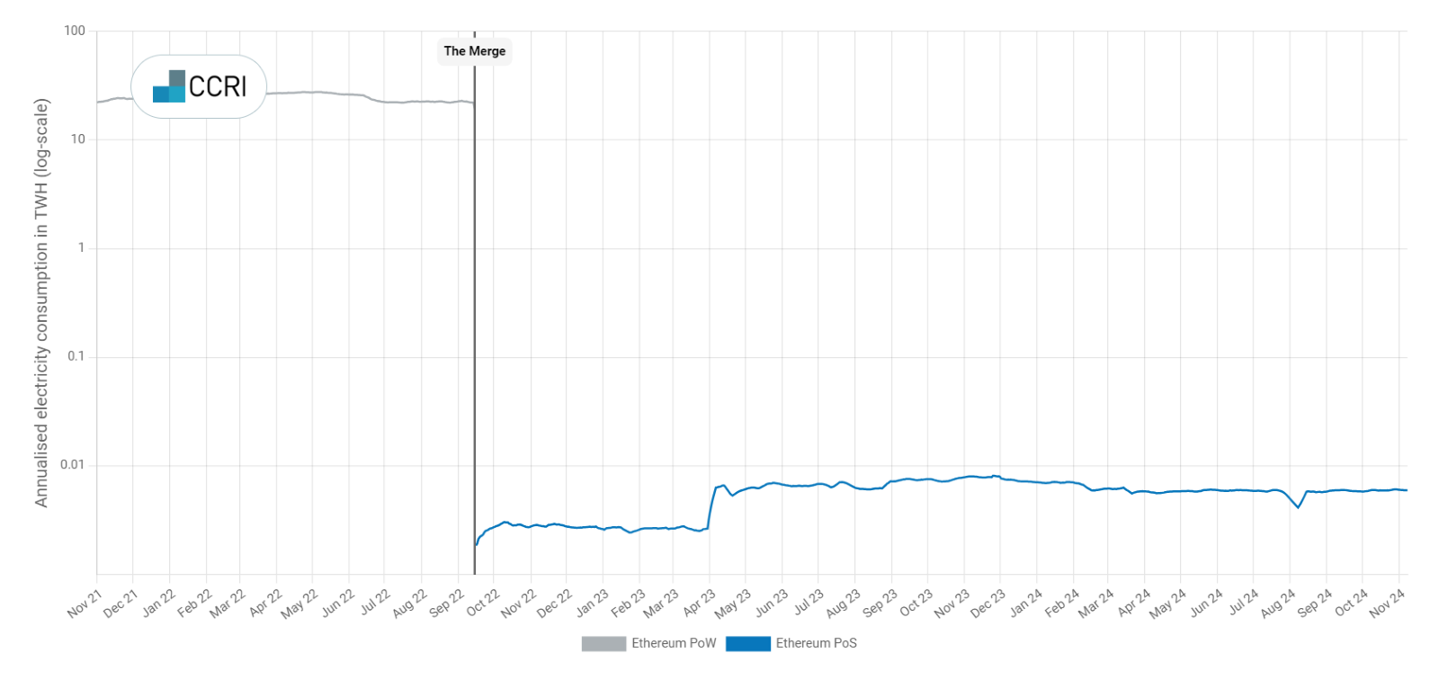
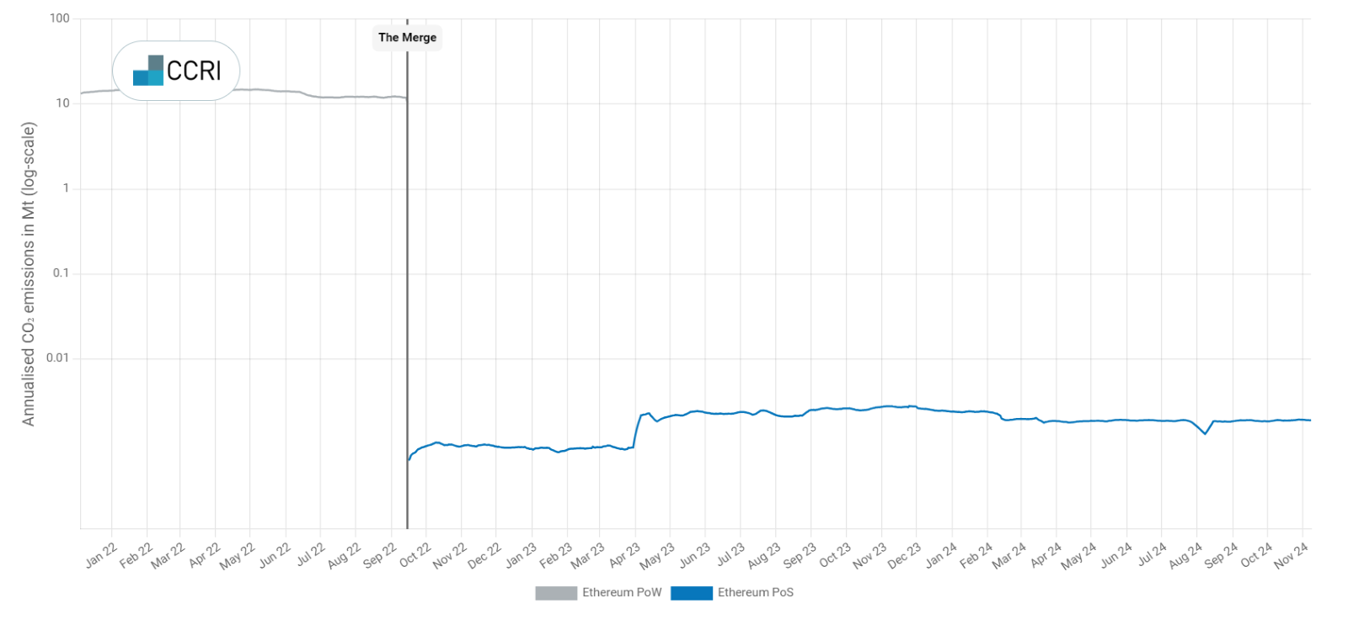

Slide 13
ETHICAL ANALYSIS
Illegal activity
Volatility of cryptocurrencies
No central control
Political and economic risk
Hypothetical stable cryptocurrencies

Slide 14
ETHICAL ANALYSIS
Transparency in Government Spending
Decentralized currency reduces governmet control
Pollution externality
Carbon footprint of bitcoin
Prooof os Staje as solution

Slide 15
CONCLUSIONS
To conclude, cryptocurrencies are the result of a series of previously developed technologies that have given birth to the form of digital money that could have been expected from the transition to a digital world. Cryptocurrencies have several advantages and disadvantages as has been underlined, however, we must consider that this technology is still evolving and getting integrated into our regulated and centralized economy, finding its place and new possible usages, while bearing in mind the moral implications. We are yet to find the place for cryptocurrencies in our economy, but we are pretty sure that cryptocurrencies are here to stay.

Slide 16
BIBLIOGRAPHY
ScienceDirect
ScienceDirect
ScienceDirect
VirtualEconomics
Kaspersky
Investopedia
ScienceDirect
Cell
ScienceDirect
Ieeexplore
Economia3
ScienceDirect
Ceeol
CoinMarketcap
Fintech
Repository
SBS

Slide 17
IMAGE BIBLIOGRAPHY
3
4
5
7
8
9
10
11
19
20
21
22
23

